Slide 1
LabMGF Warehouse Manager

Slide 2
What is it?
It is an all-in-one tool developed to simplify the management of the equipment in the LabMGF warehouse of related documentation and sharing.

Slide 3
Who will use it?
Basic users: will be able to make requests to reserve a list of instruments and accessories, view the status of their requests and download documents related to approved requests, report malfunctions or defects of instruments or accessories.
Superusers: will be able to add, remove, edit and link equipment and documentation, view user reports
Administrators: will be able to change user roles, approve, reject or mark as pending user requests

Slide 4
What architecture is it designed with?
The back-end code was developed using Jakarta Servlet 10.0.
The front-end code was developed using HTML and JavaScript.
The database code was developed using MySQL 8.
The web Server is managed by Tomcat 10.

Slide 5
What external libraries were used?
Front-end:
Bootstrap 5 for style management
bootstrap-table for table management
full-calendar for calendar management.
iconsvg.xyz for icons selection
Back-end:
mysql-connector-j for database connection
jakarta mail for mail management
google gson for json management (used in client communication and for reading config files)
bcrypt for secure password management.

Slide 6
How is the security implemented?
There are three filters in order to access any resource:
UserChecker: this will check that either the resource is public, or the user is authenticated.
SuperUserChecker: for any action or resource that needs superuser’s clearance, this filter will block any basic user request.
AdminChecker: for any action or resource that needs superuser’s clearance, this filter will block any basic user or superuser request.
Since the service will be used in local network (or possibly via VPN), it doesn’t implement any https strategy.
All passwords are stored as hashed strings and cannot be decrypted by anyone.
No sensitive information is ever sent to the client.

Slide 7
How will the service be accessible?
The software will run as a service in an Ubuntu server 22.04 virtual machine hosted by a Windows 10 server.
A proxy can be used to get a simpler address, but for the moment the website will be reachable at
virtual machine IP
port: 8080
path: /LabMGFWarehouseManager/
When any action concerns a user, they will receive an email from the service, notifying the news.

Slide 8
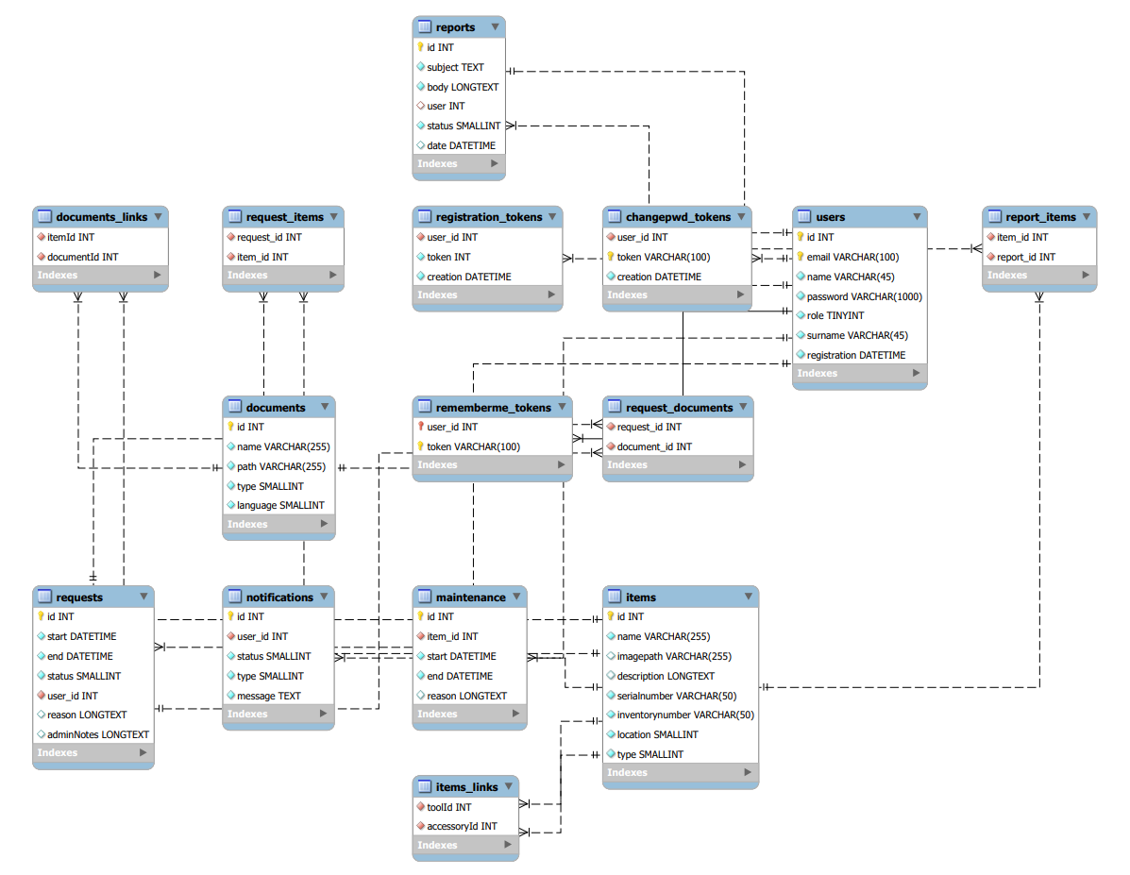
How is the Database structured?

